Slide 1

The absolute beginners guide to excel
Vadim acosta

Slide 2

outline
Getting Started
The Interface
Data Entry
Functional Aesthetics
Congratulations!

Slide 3
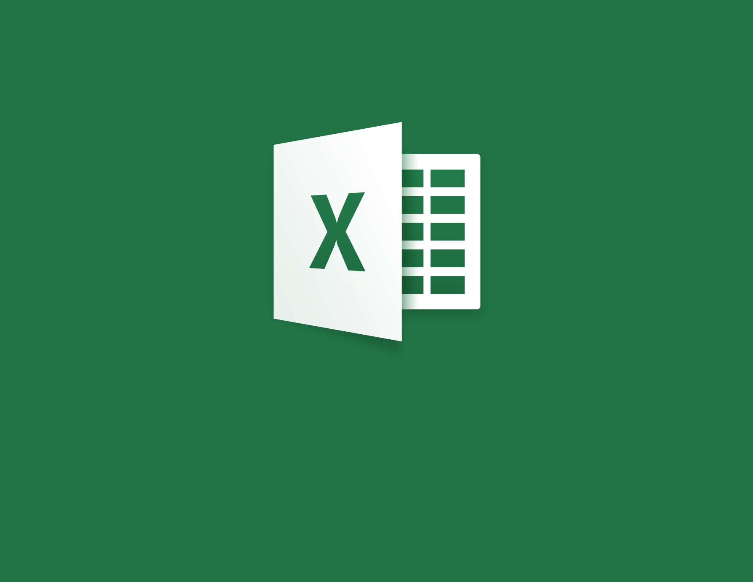
Getting started
Click on the Excel Icon

Slide 4
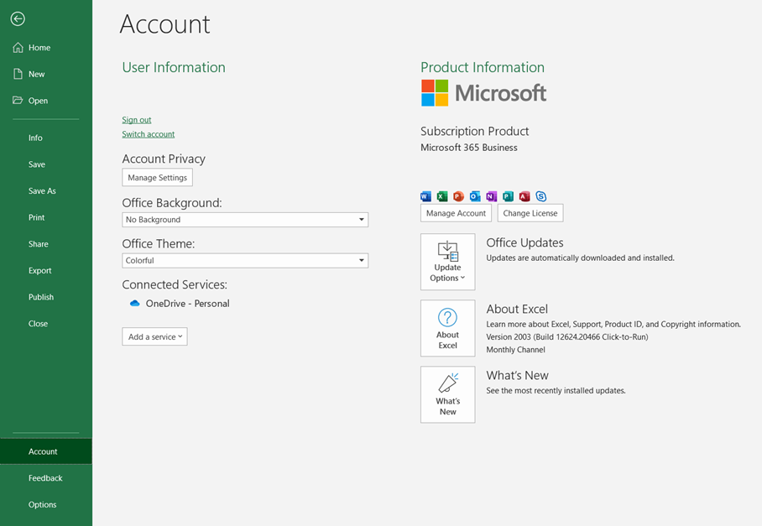
Version control
All examples shown on the Microsoft Excel 365 Business, 2019 update
To check your version go to File -> Account -> About Excel

Slide 5
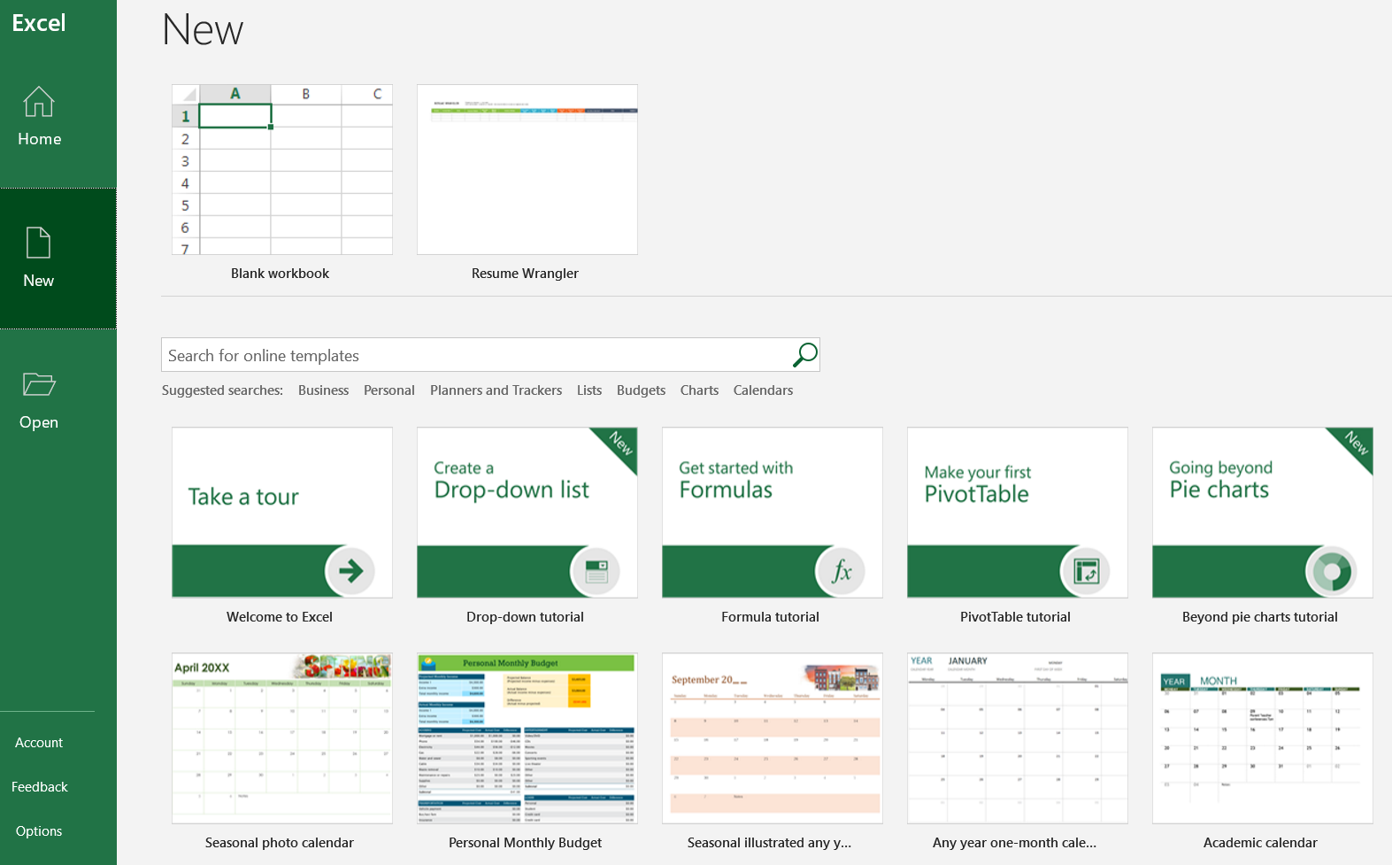
It starts
Click New
Check out tutorials
Check out templates
Start with a Blank Workbook

Slide 6

The interface

Slide 7
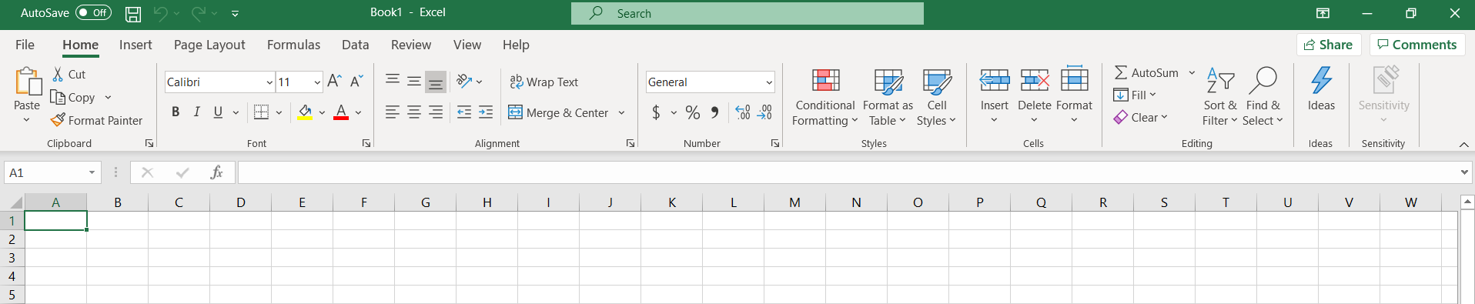
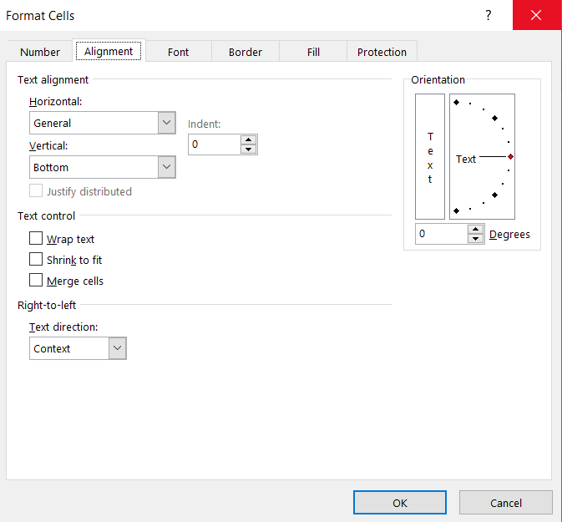
Terminology
TABS
RIBBON
GROUPS
EXPAND

Slide 8
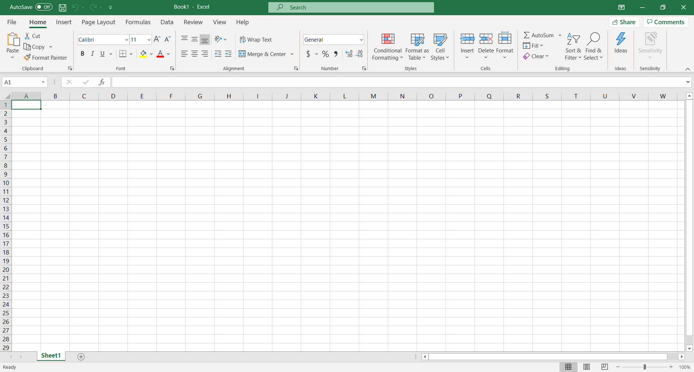
The spreadsheet
Spreadsheet
Spreadsheet tab (double click to rename spreadsheet)
Click on the (+) button to add a spreadsheet to your workbook

Slide 9
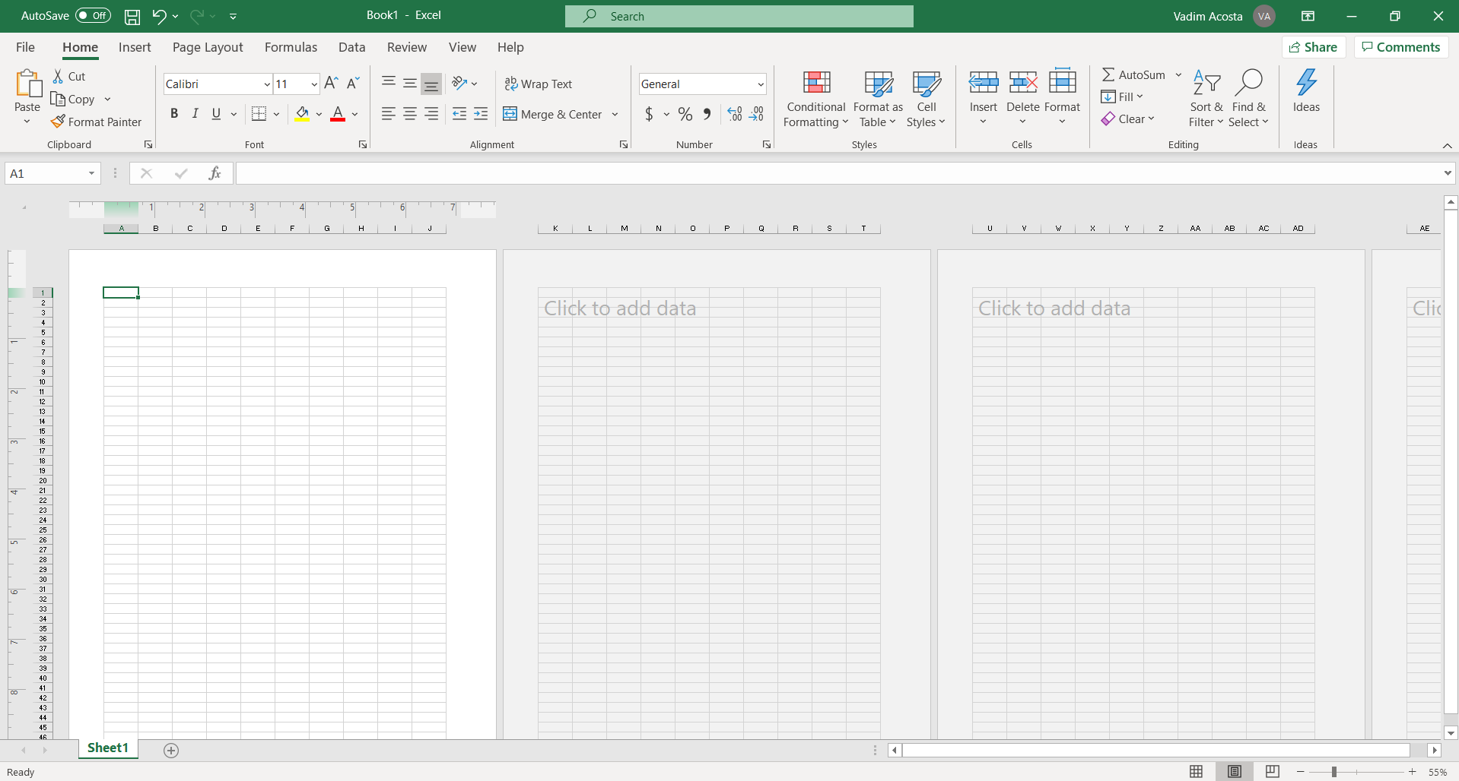
View adjustment
Click here to get a preview of your spreadsheet printed on A4 paper

Slide 10
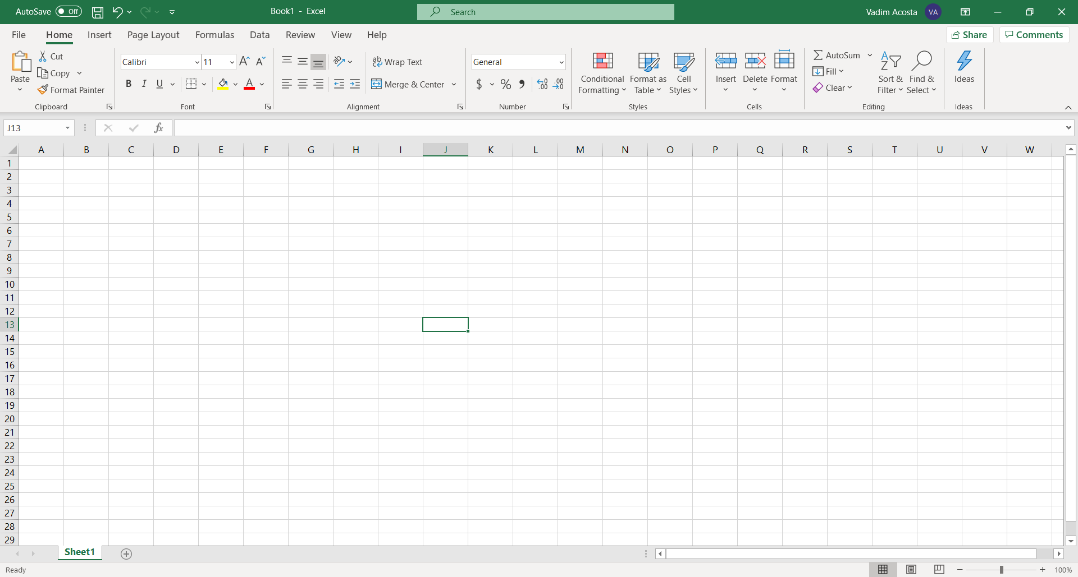
Columns and rows
Columns are vertical and lettered
Rows are horizontal and numbered
PowerPoint conforms with color theory
The coordinates of a cell are given as Column then Row Ex: J13

Slide 11

Fun facts
Each Excel spreadsheet can support up to 1,048,576 rows and 16,384 columns of data that’s a whopping 17,179,869,184 cells!
Each cell in a spreadsheet can contain up to 32,767 characters
If every cell in a spreadsheet was filled to maximum capacity a single excel spreadsheet would contain over 56 trillion characters!
This is still nowhere close to what is needed to manage truly Big Data!

Slide 12

Selecting a cell
Your mouse cursor will turn into a cross as you hover it over the spreadsheet
To select a cell click on it
Now you can write in the cell
hello

Slide 13
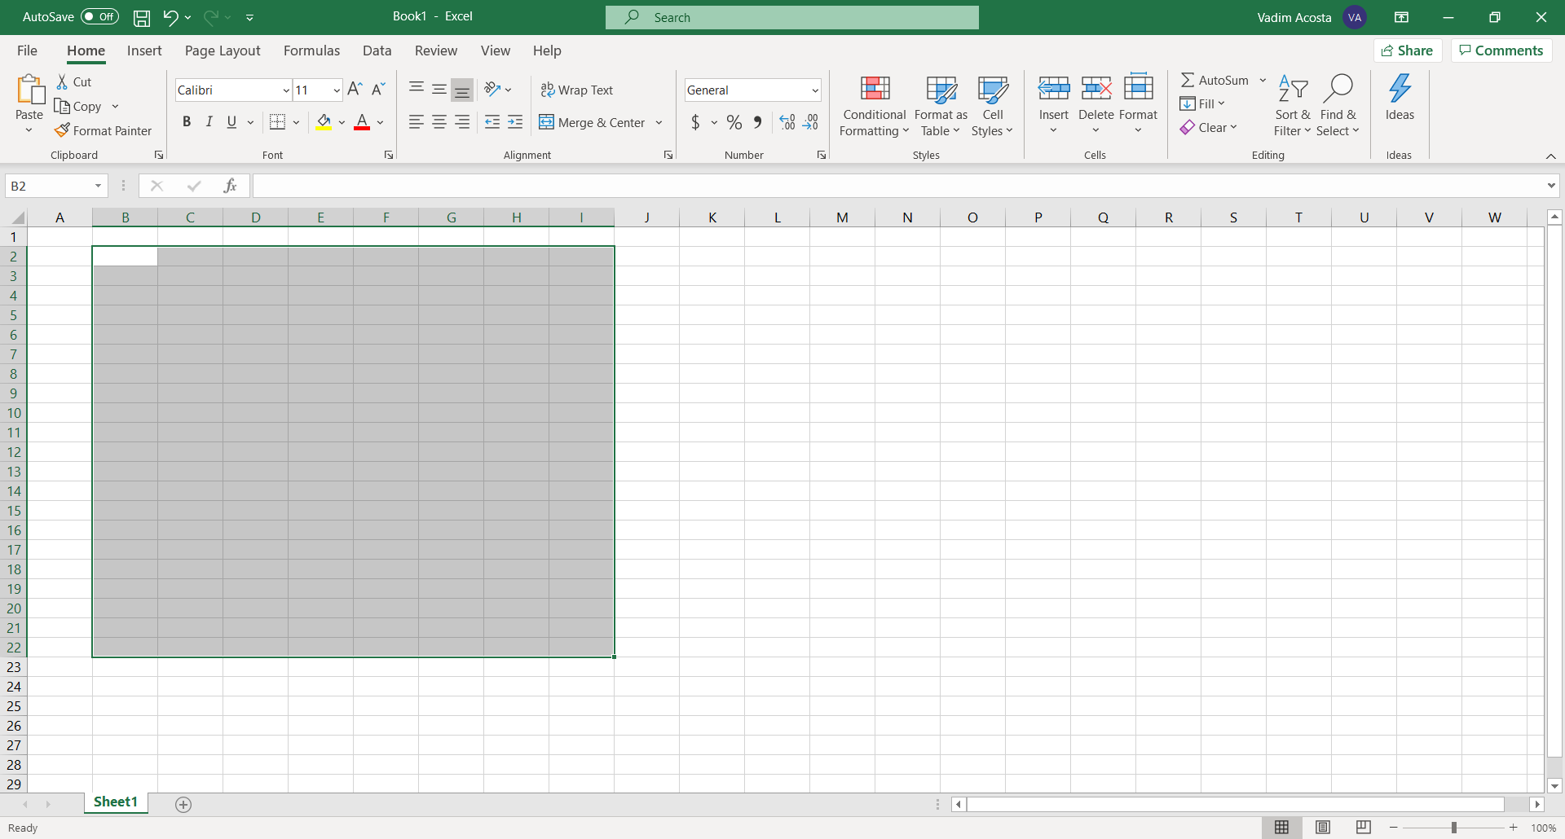
Selecting multiple cells / range
To select multiple cells just click and drag cursor
This is a range of cells

Slide 14
range
Find the name of the top left cell in the range (B2)
Find the name of the bottom right cell in the range (I22)
The name of the range is ‘B2:I22’
Read out loud as B2 through I22

Slide 15

Data entry

Slide 16
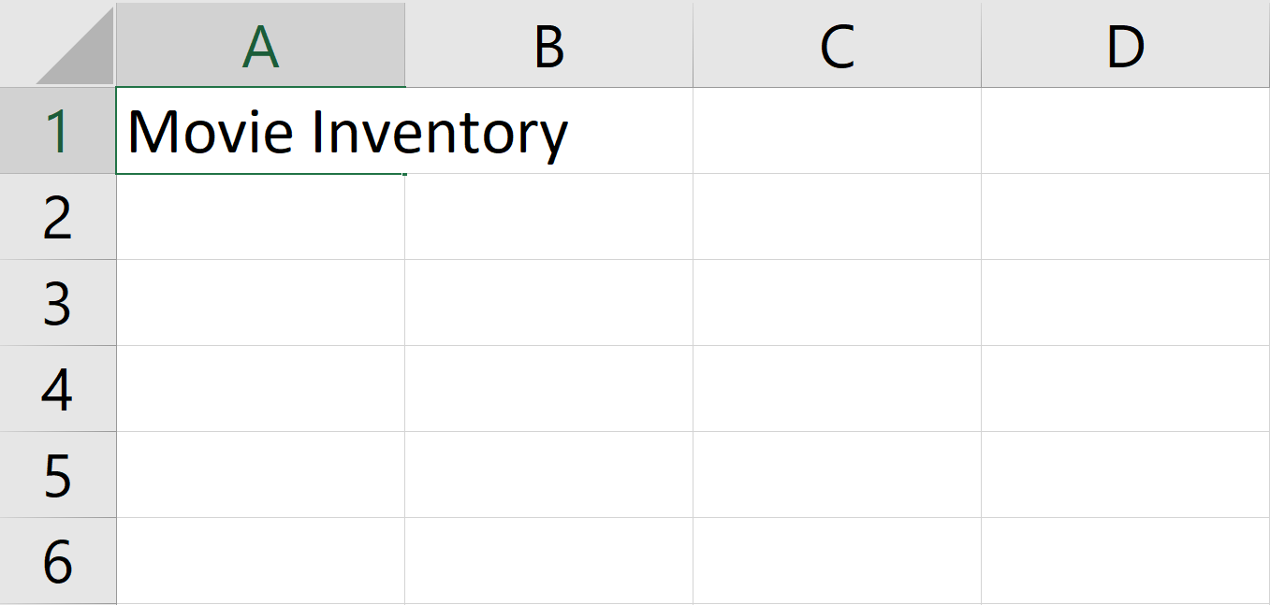
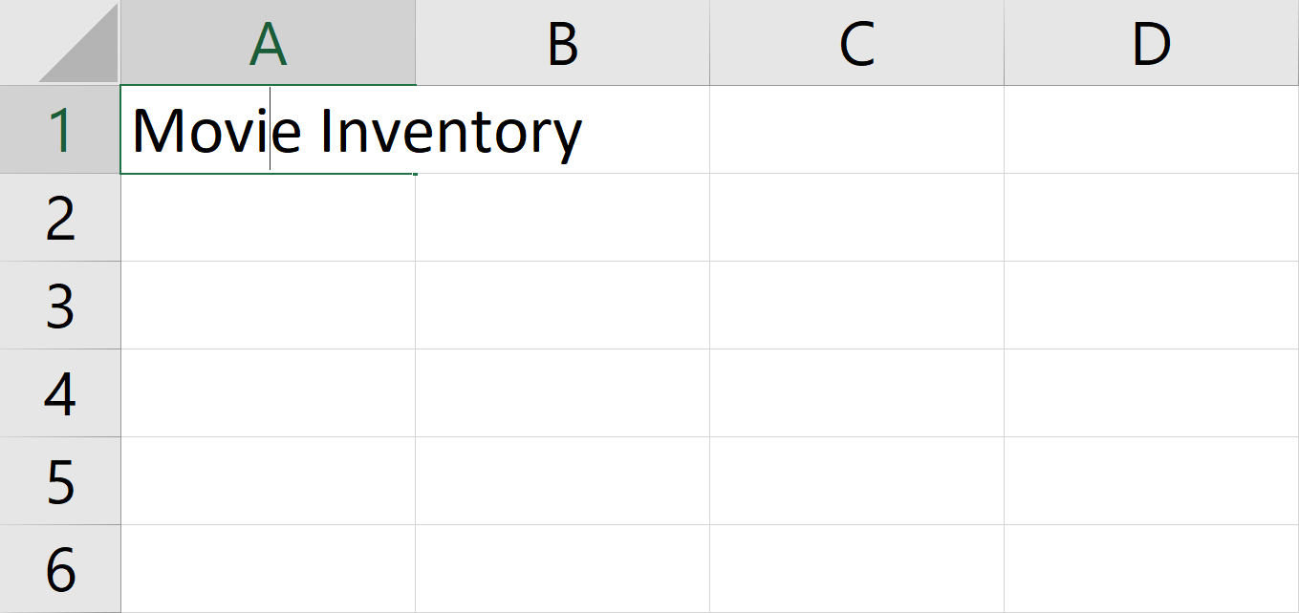
Data entry
On a cell. Click on a cell and write a column name
In a cell. Double click on a cell with text in it to alter text without replacing it. Watch for insertion point to confirm
The text can exceed the size of the cell

Slide 17
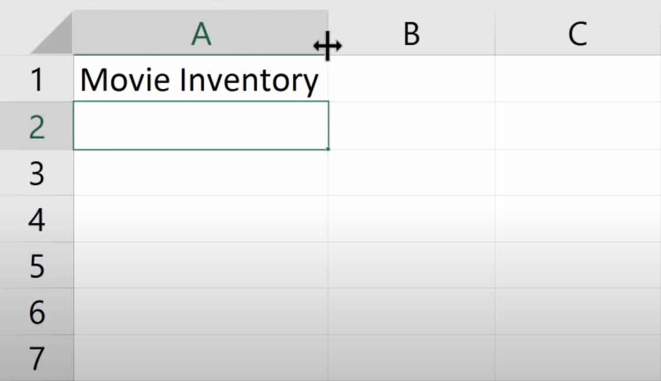
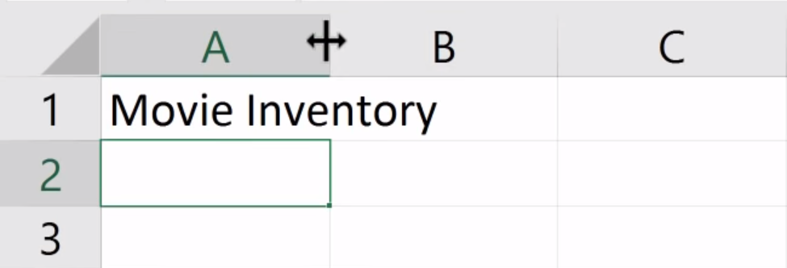
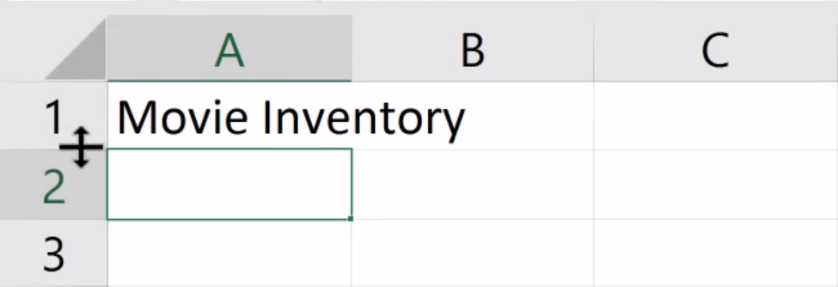
Cell size
Hover your mouse over the border separating two columns or rows
Your cursor will turn into a double-sided arrow
Click and drag the border to fit it to your preference
Double click for an automatic adjustment
Press “Enter” to move down one row

Slide 18
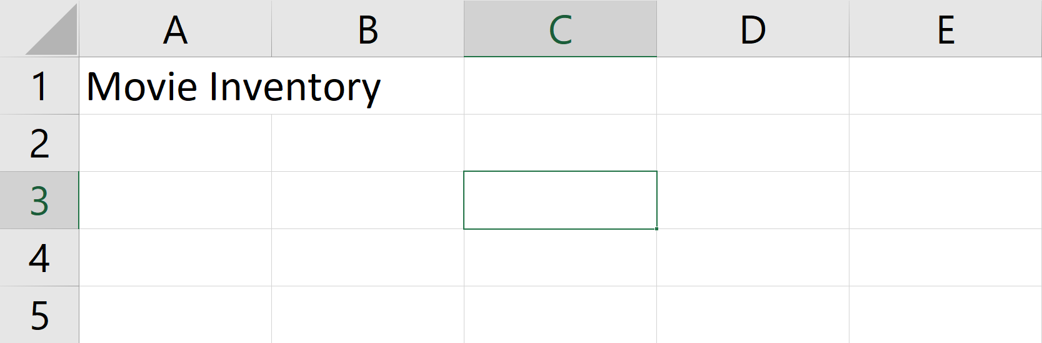
Selecting a cell
Push “Enter” to move one cell down
Push “Shift” + “Enter” to move one cell up
Push “Tab” to move one cell right
Push “Shift” + “Tab” to move one cell left

Slide 19
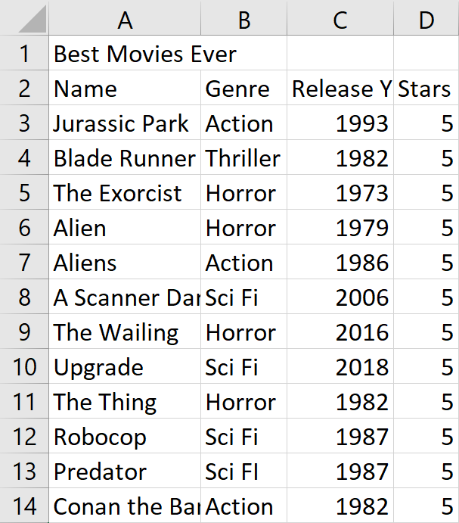
Woots! You can make a spreadsheet!

Slide 20

Make it beautiful

Slide 21
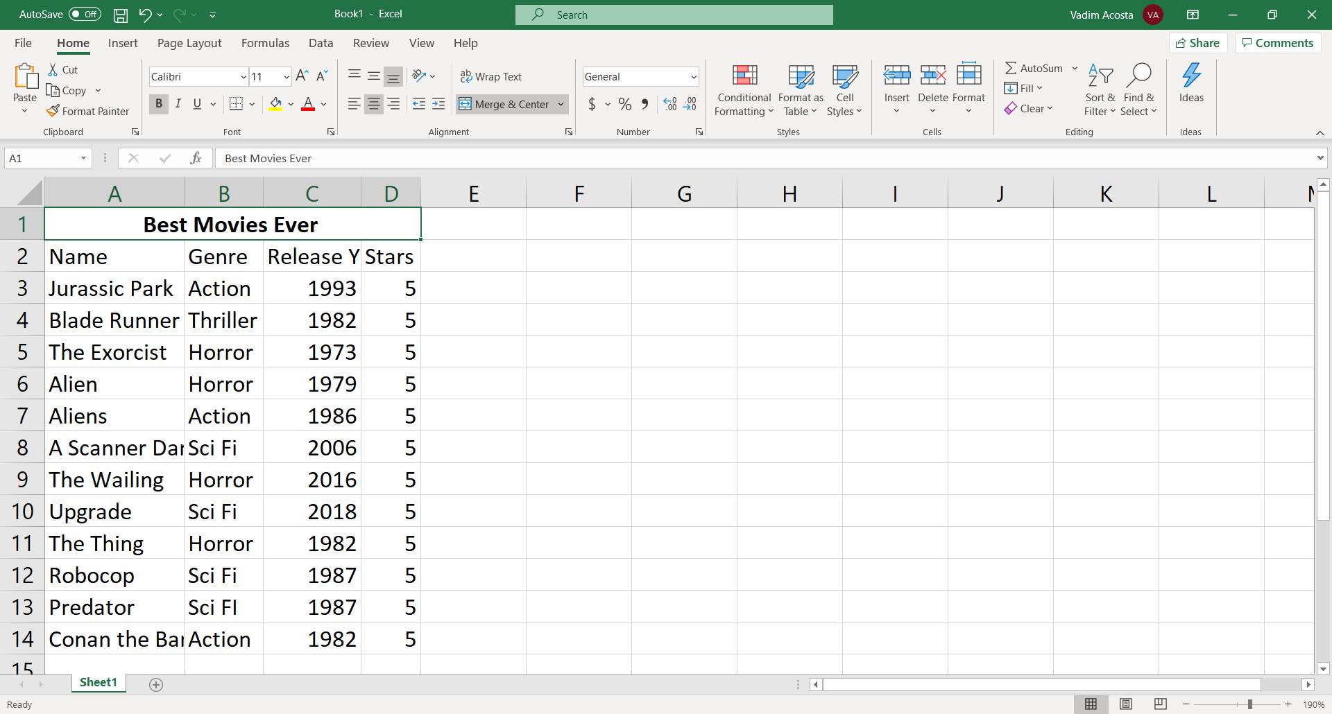
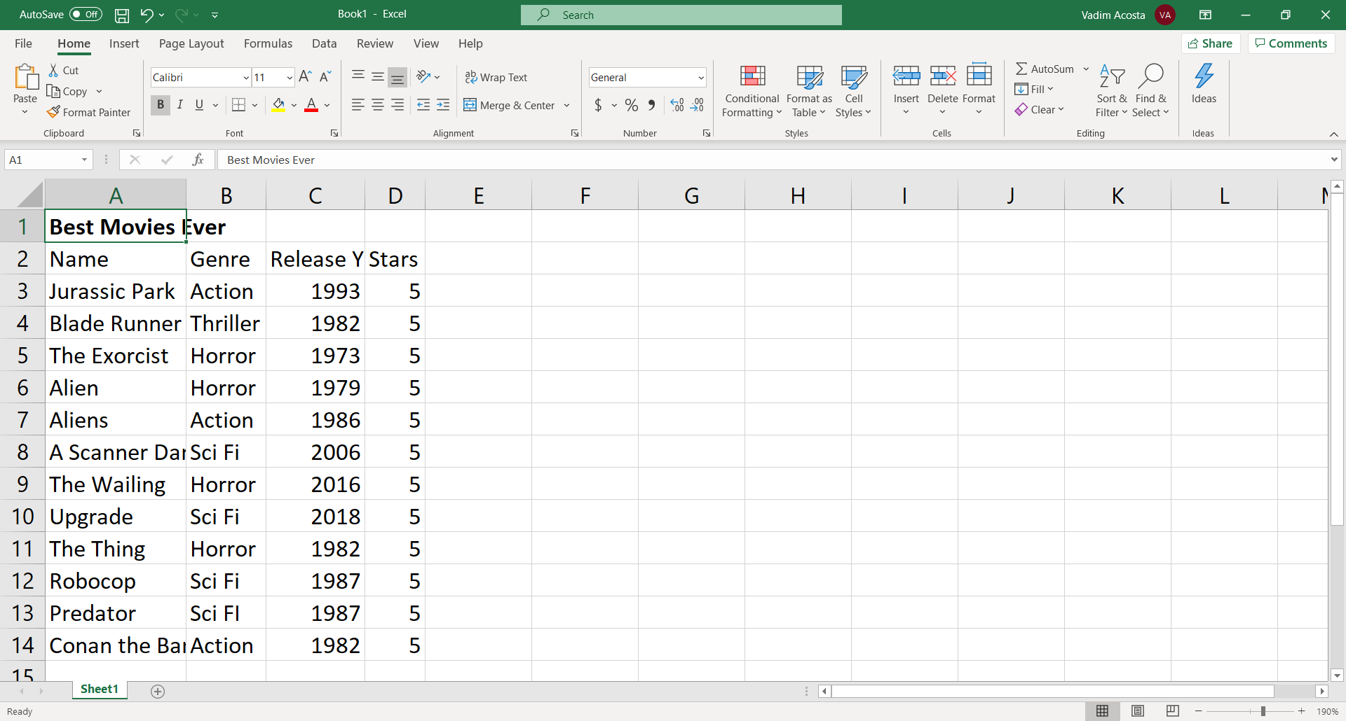
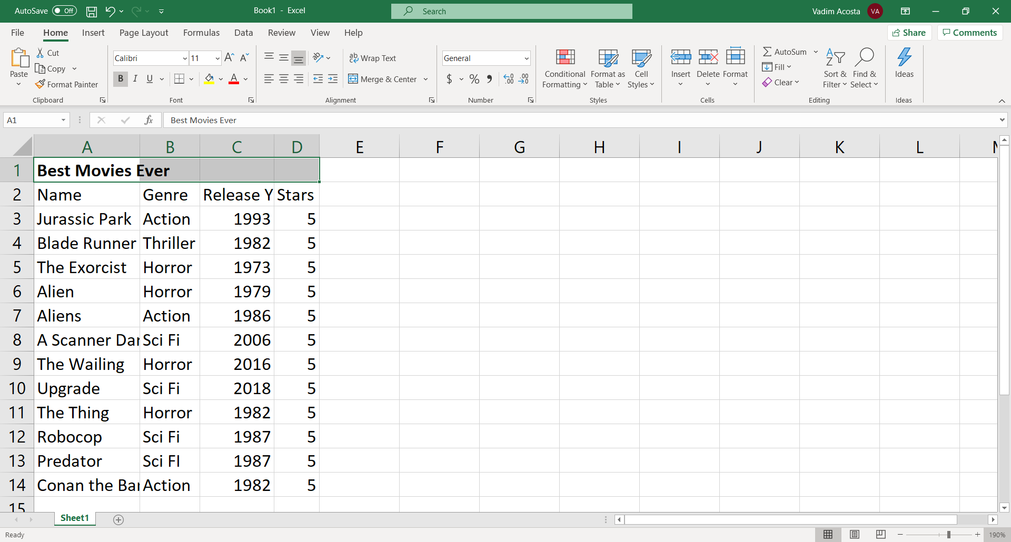
Aesthetics
Click B in the font group to bold the title, I to italicize and U to underline
Highlight the top row above all the columns and click “merge center” in the alignment group

Slide 22
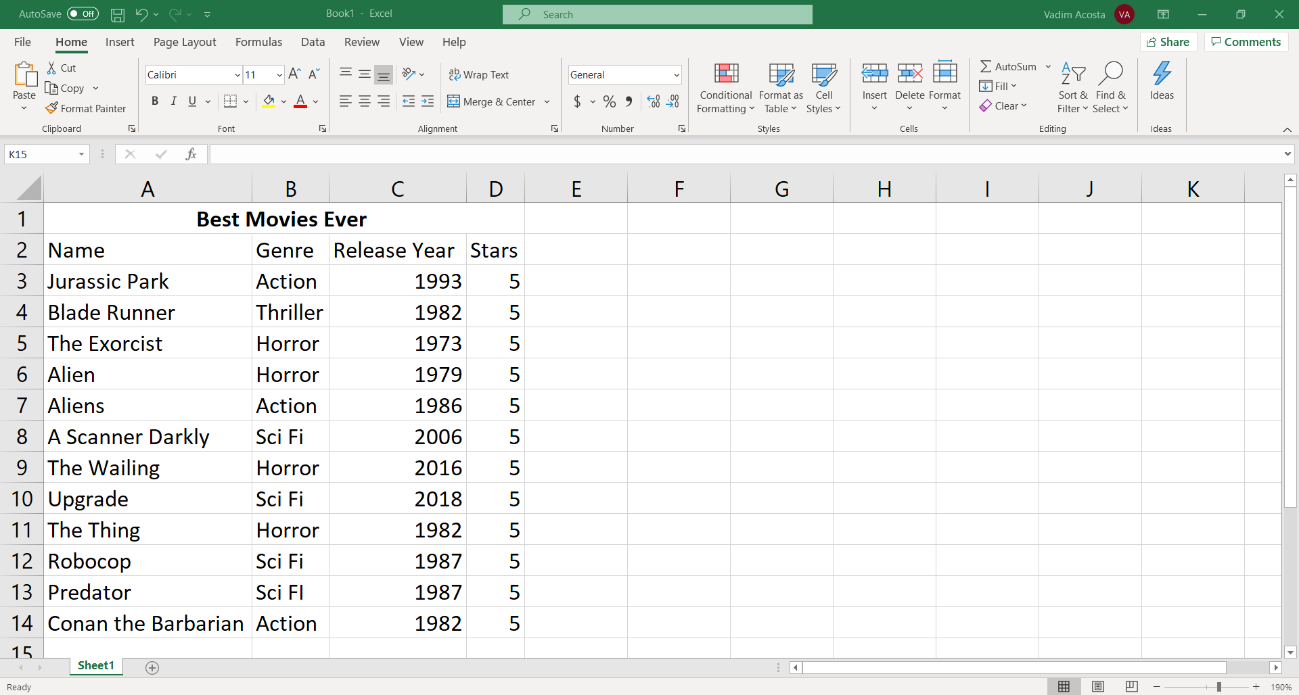
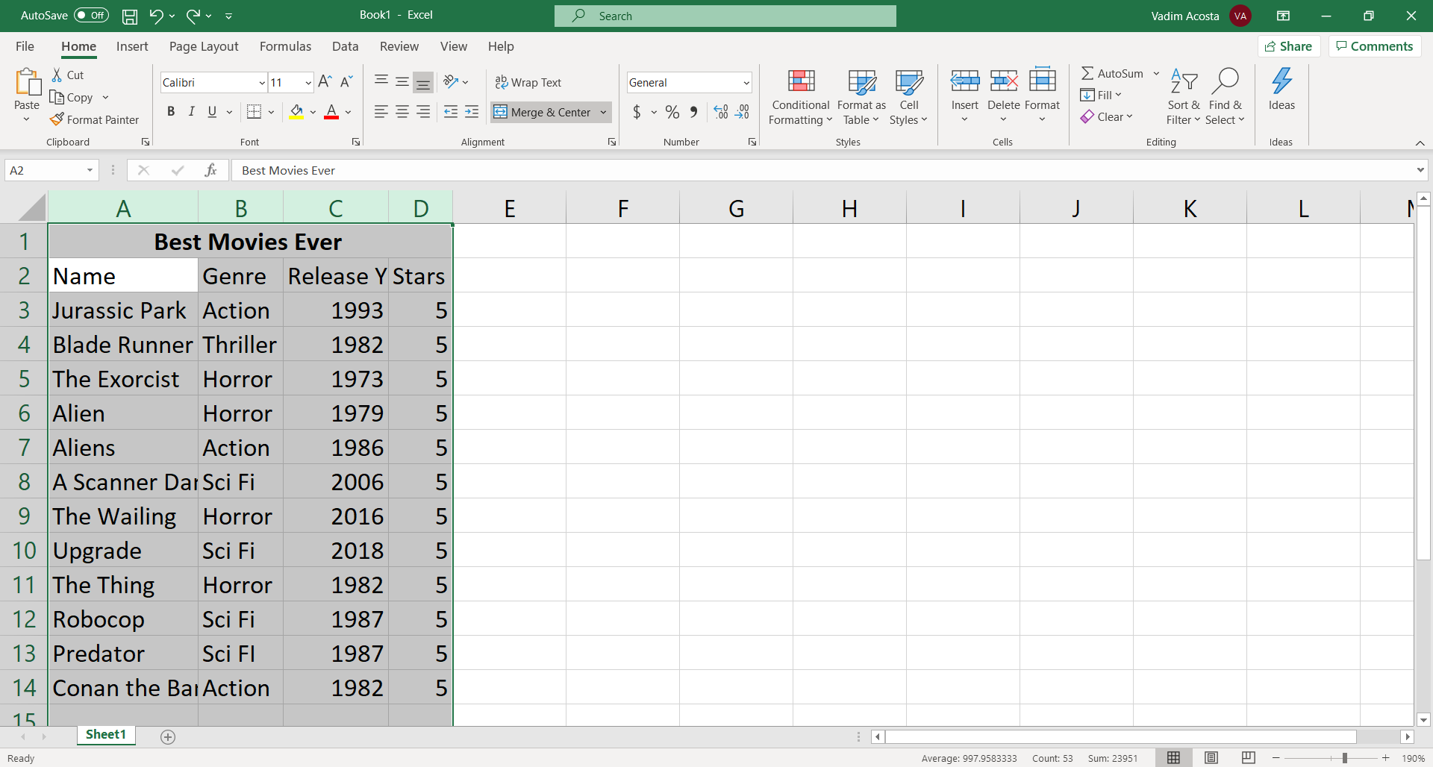
Properly spaced
Click and highlight the column names in your table. In this case A:D
Double click on any of the borders between the columns
All selected columns now fit your text

Slide 23
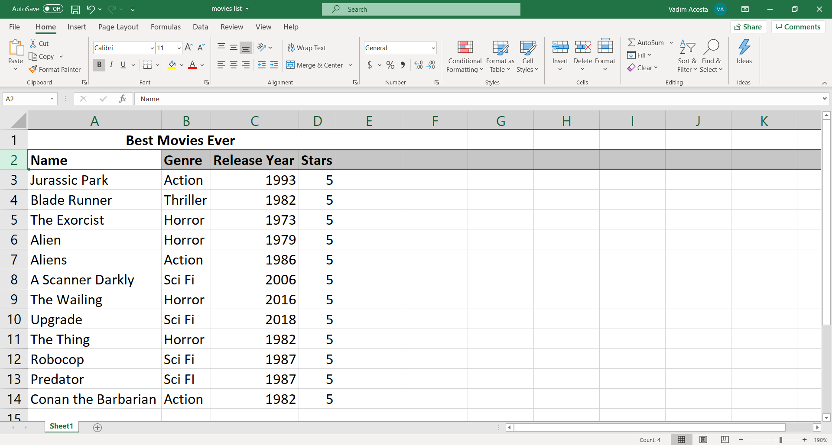
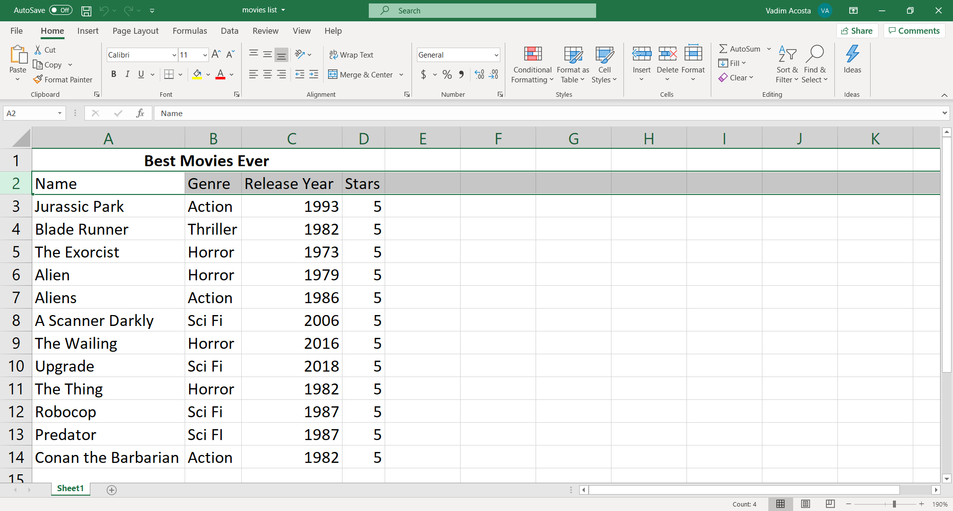
Bold columns
Highlight a row and press B to bold all headings

Slide 24
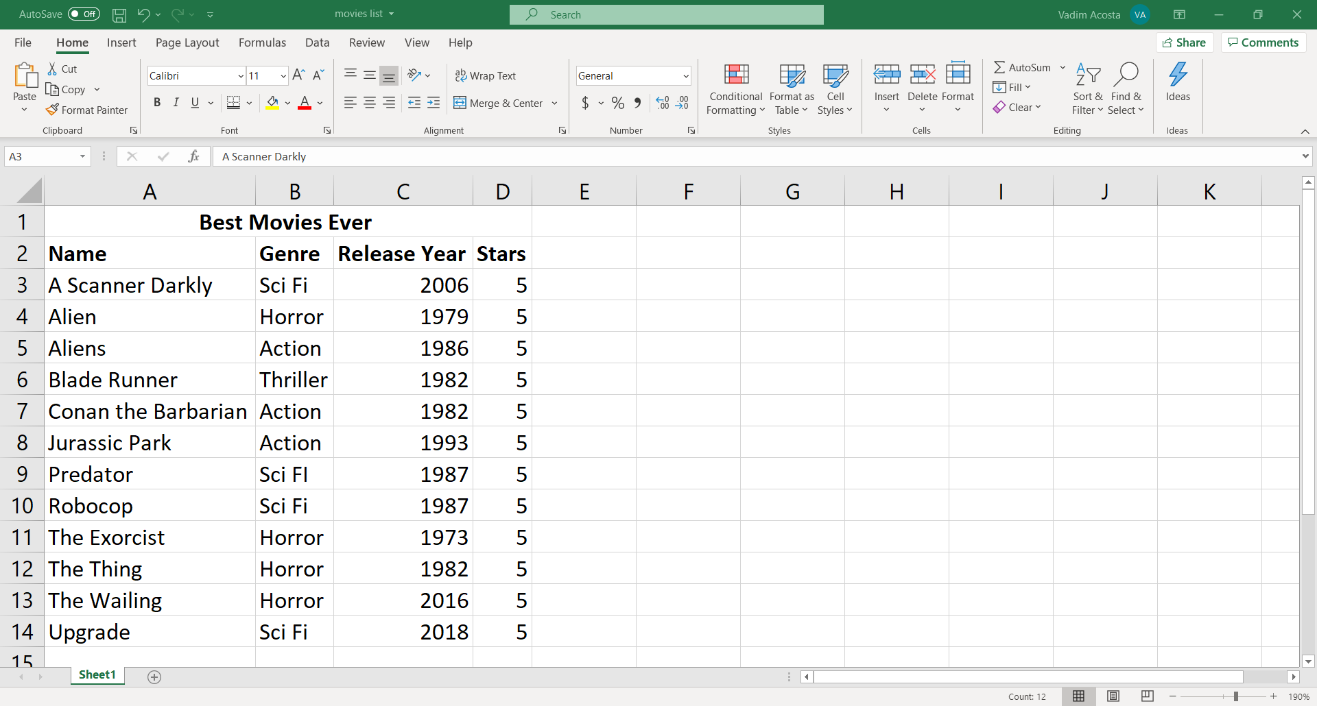
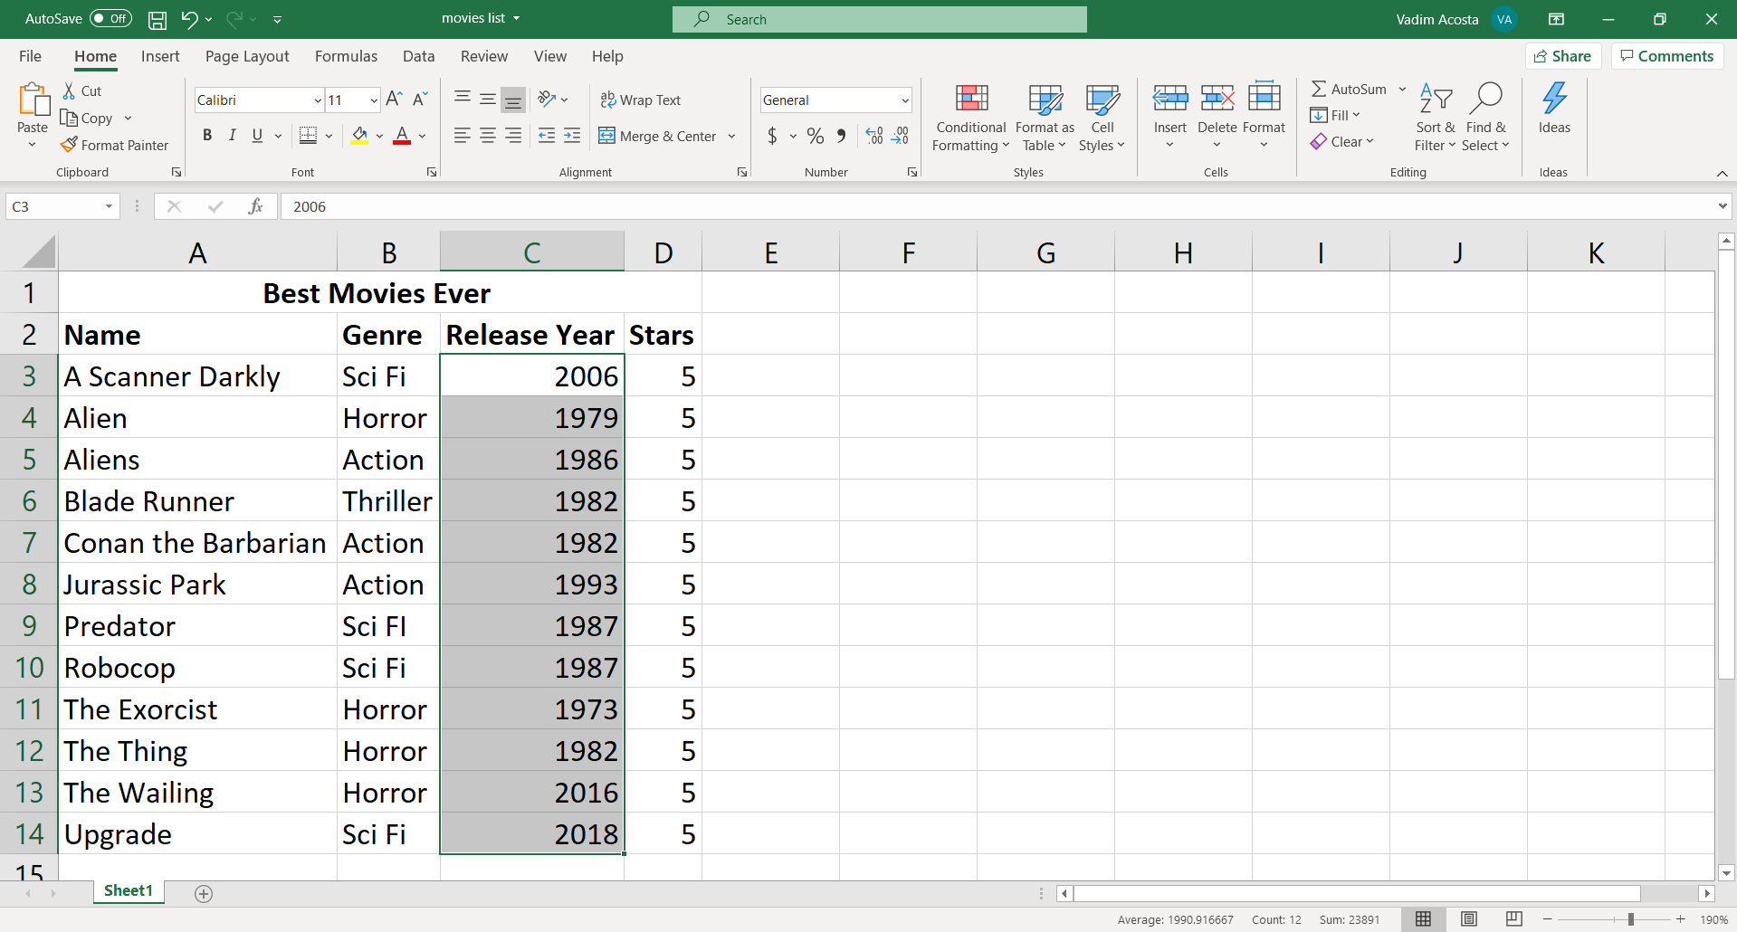
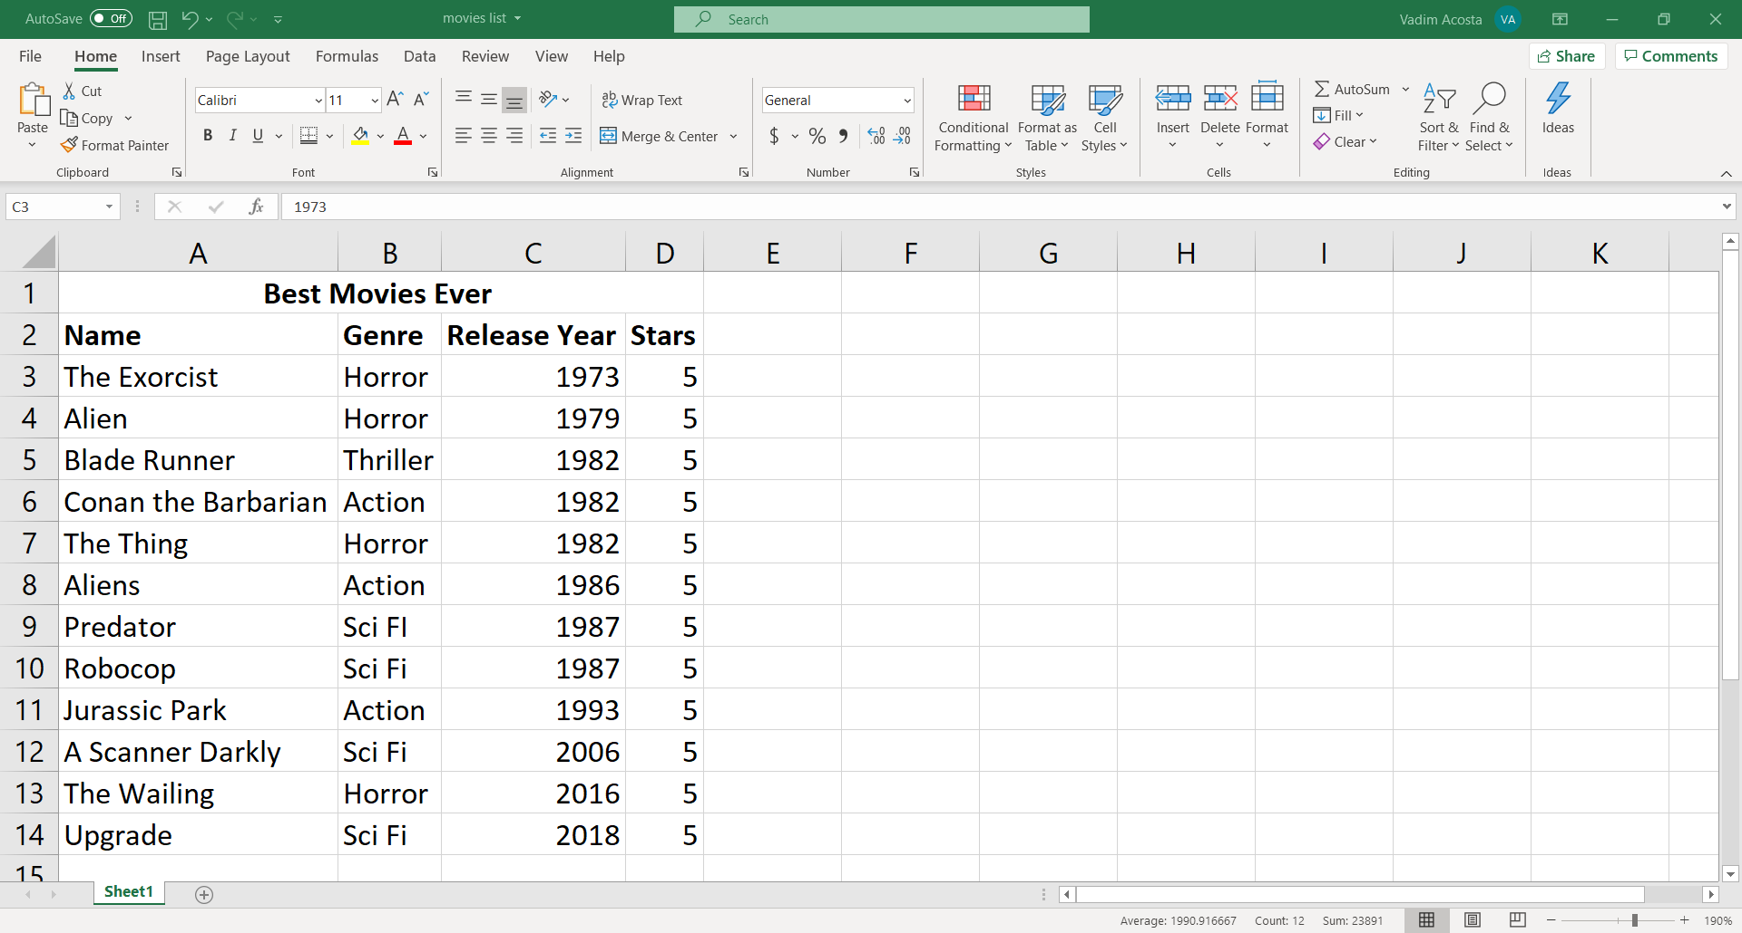
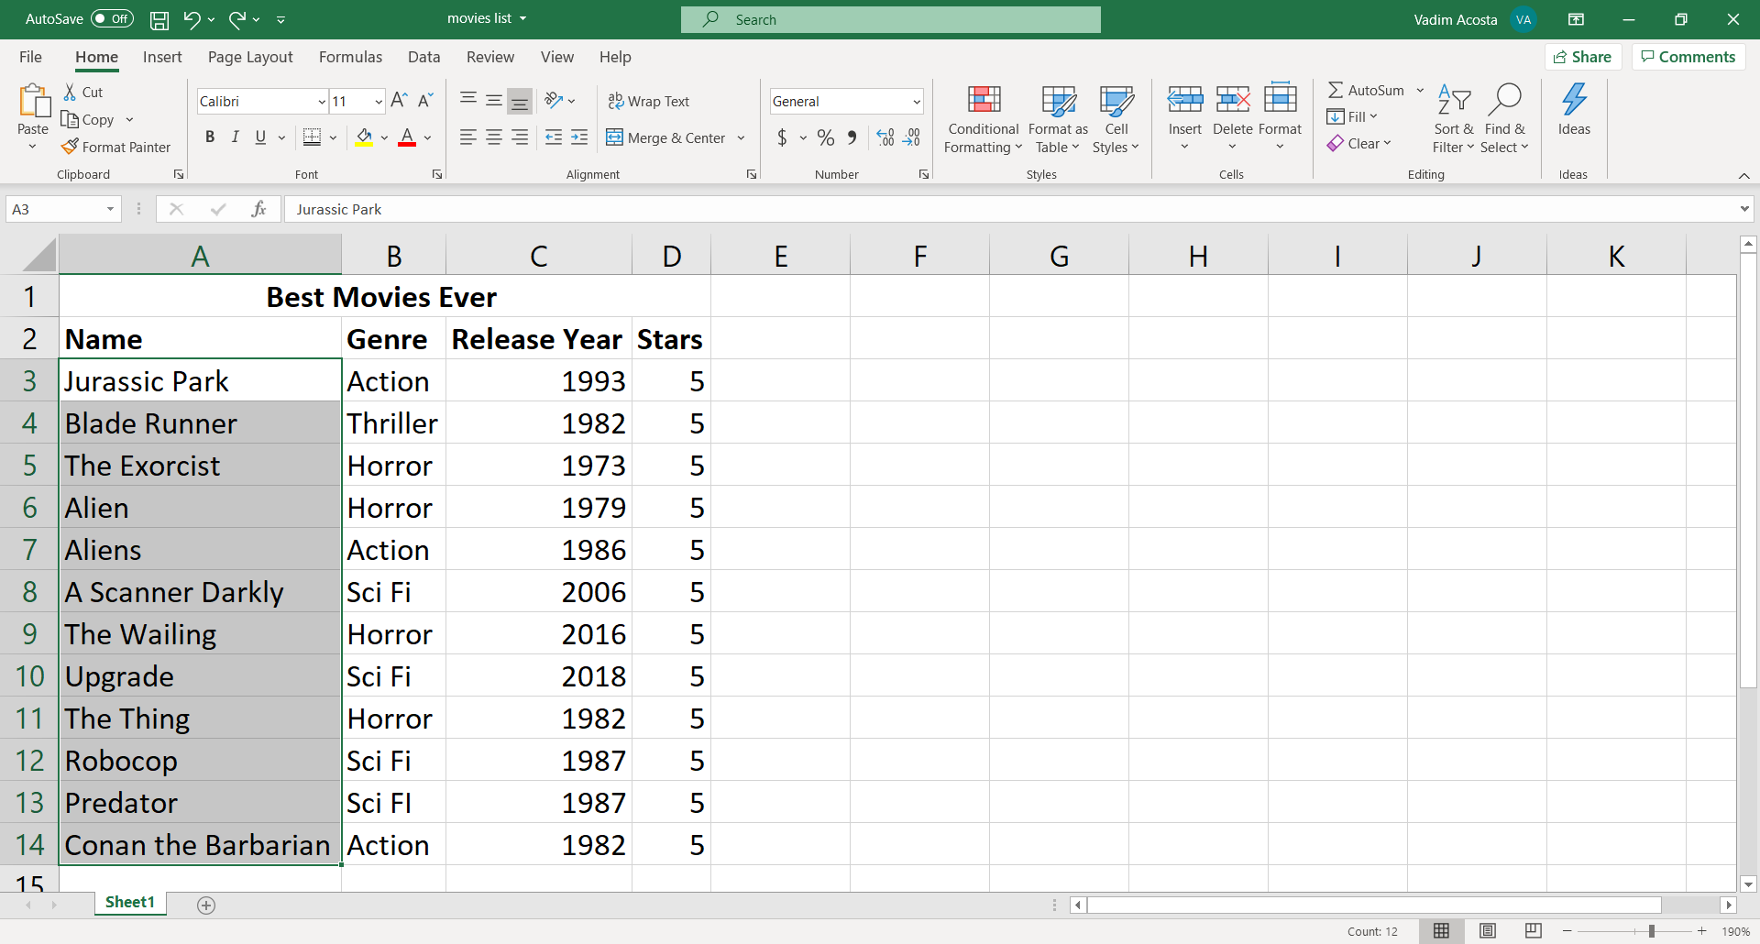

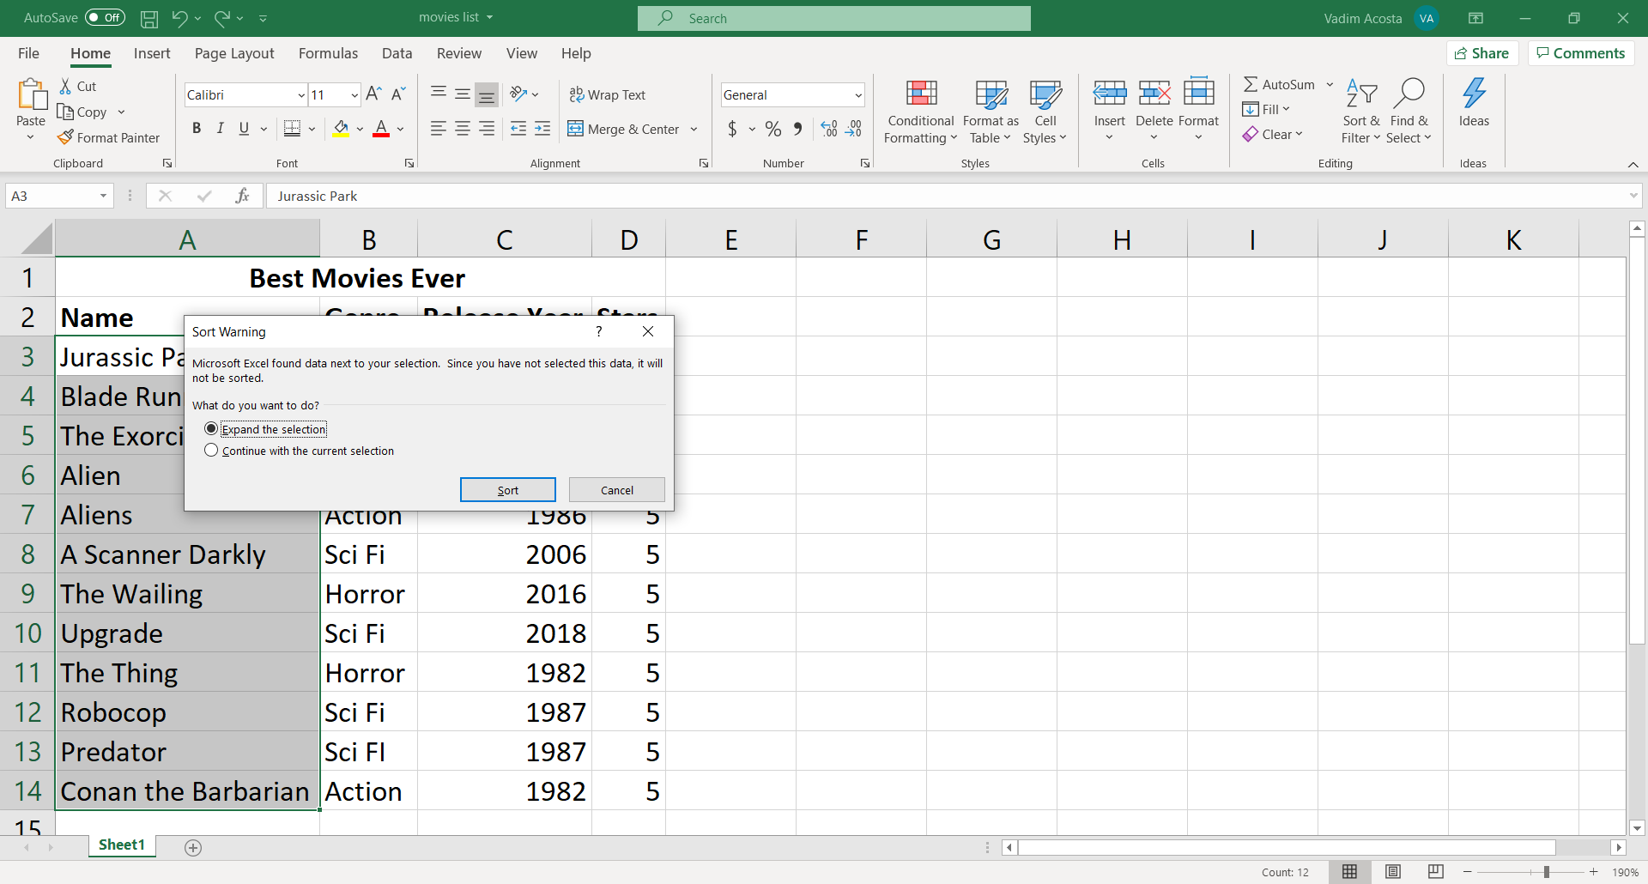
Order rows
Highlight the rows
Click on “Sort and Filter” in the Editing group
Select “Sort A to Z” for ascending order. Select “Sort Z to A” for descending order
Keep “Expand the selection” selected and click “Sort”
Magic!
Also works for numbers

Slide 25
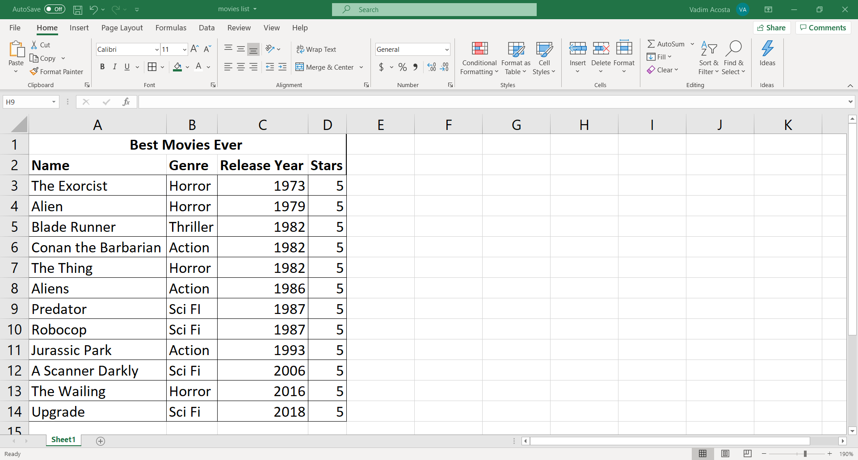
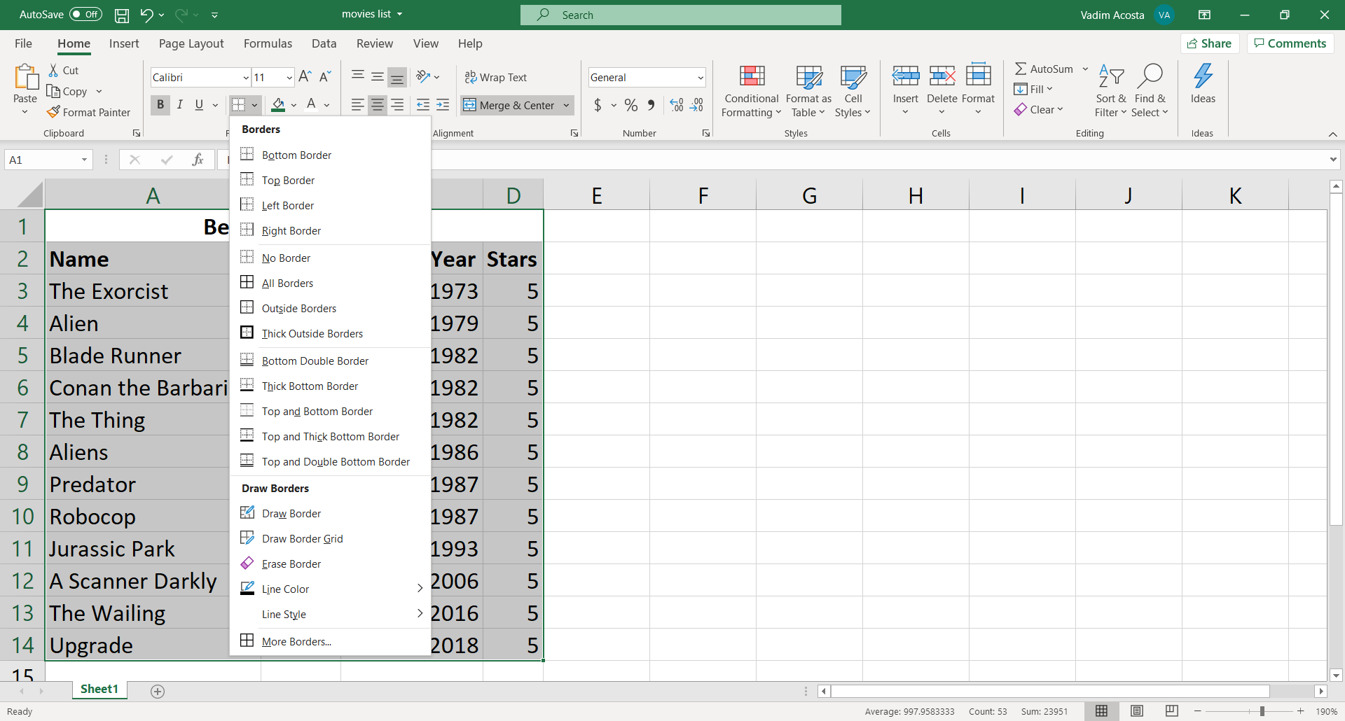
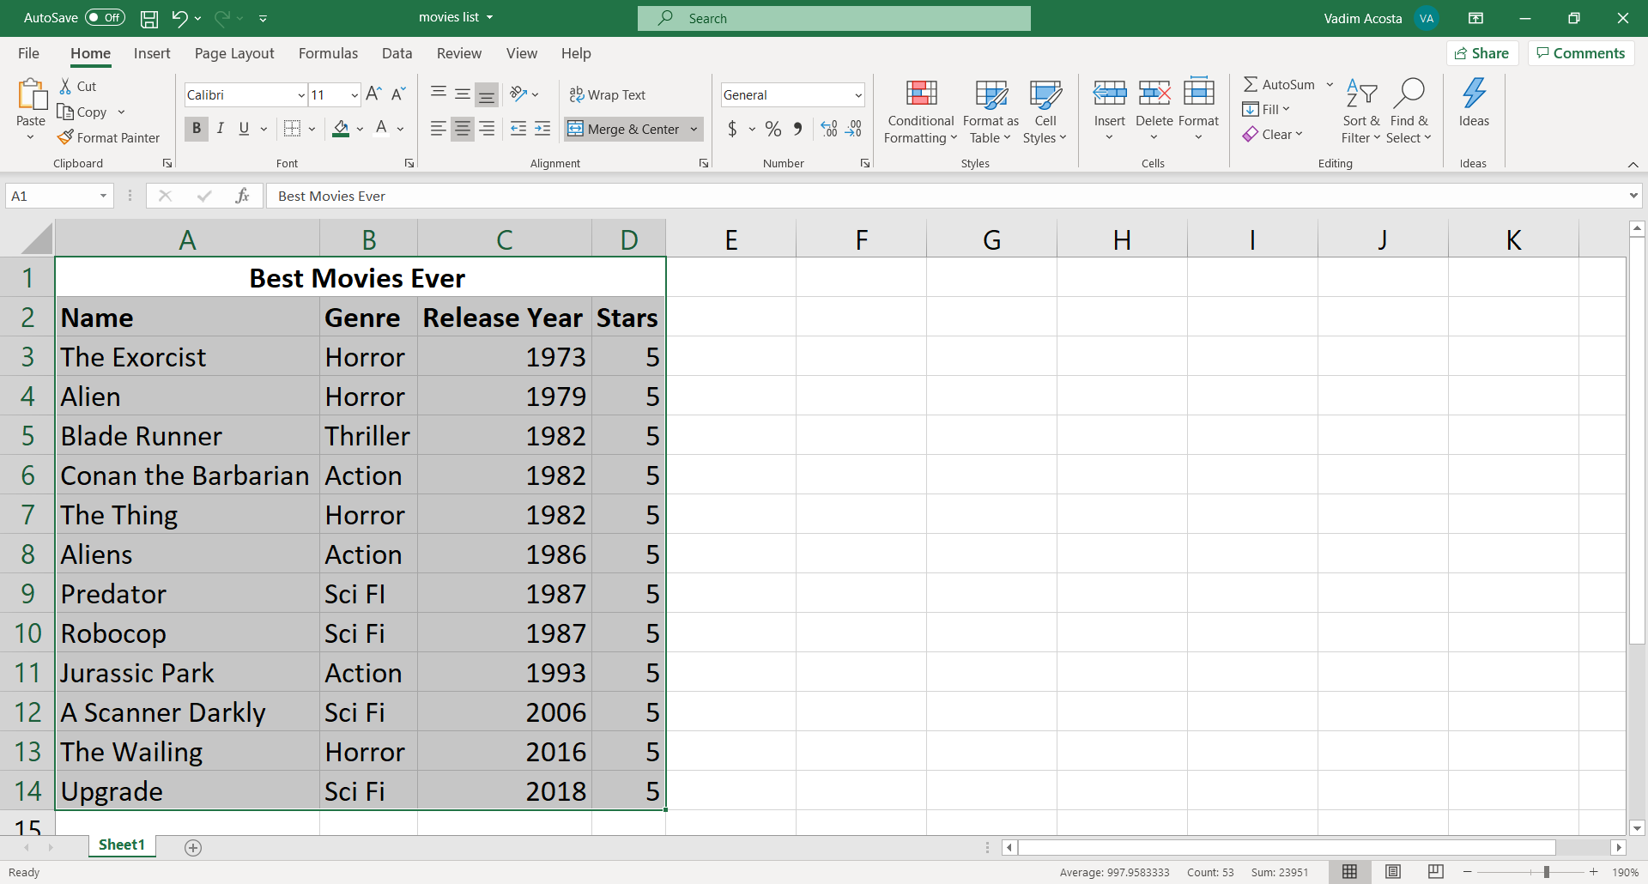
Add borders
Highlight your table and click on the downward arrow next to the grid in the Fonts group
Pick your favorite style of border
Voila

Slide 26
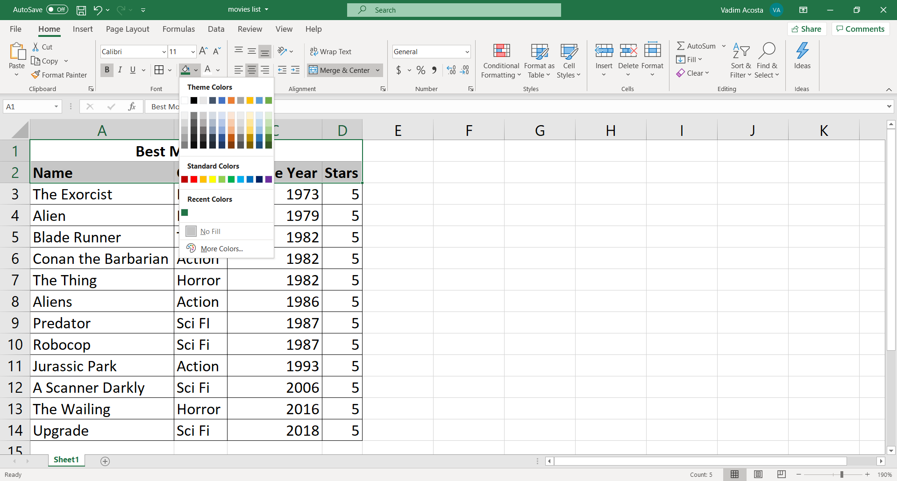
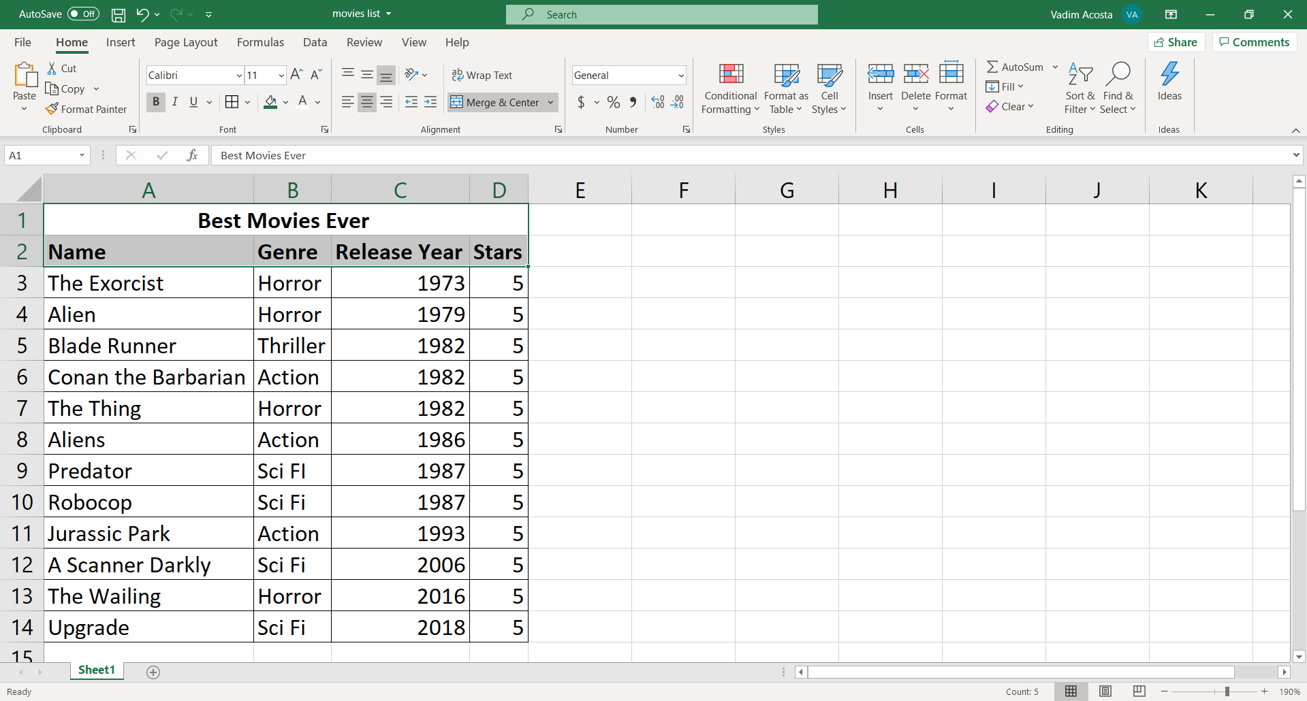
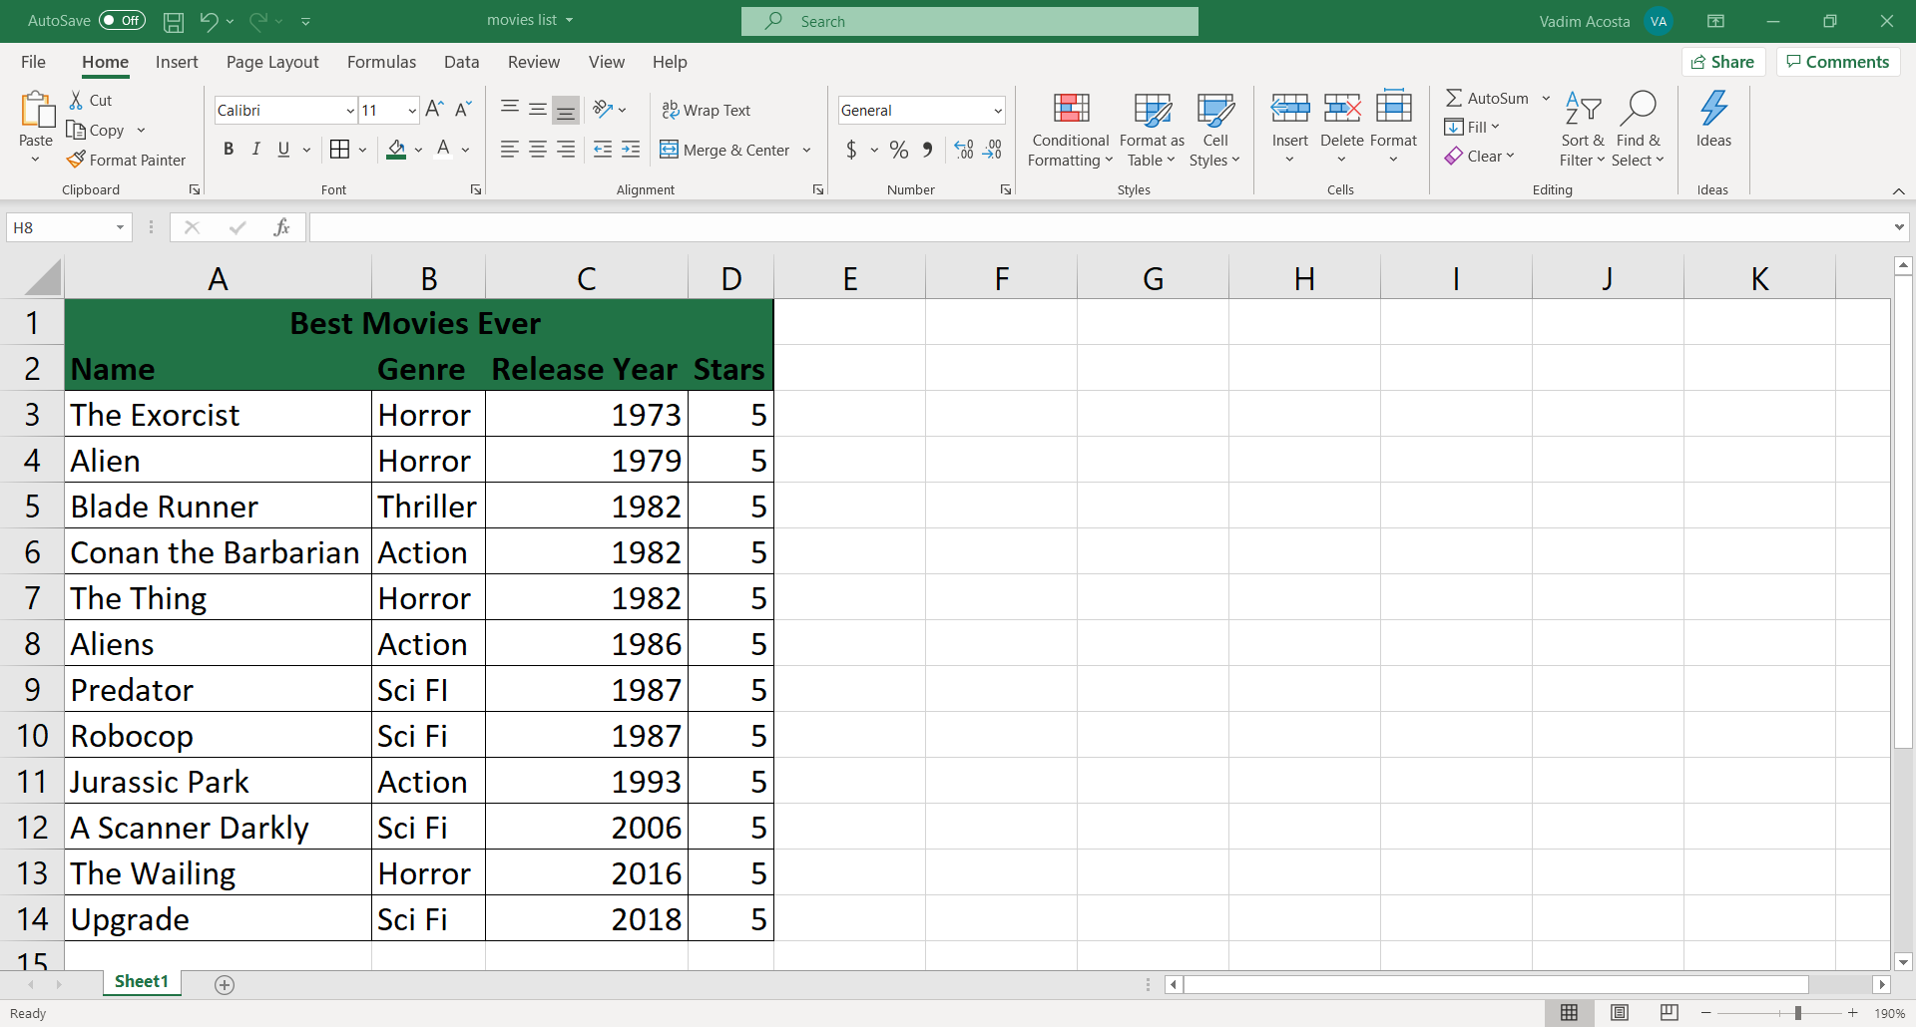
Cell color
Highlight the cells you want to color click on the downward arrow next to the paint can in the Fonts group
Pick your favorite cell color
Pretty good, needs something else.

Slide 27
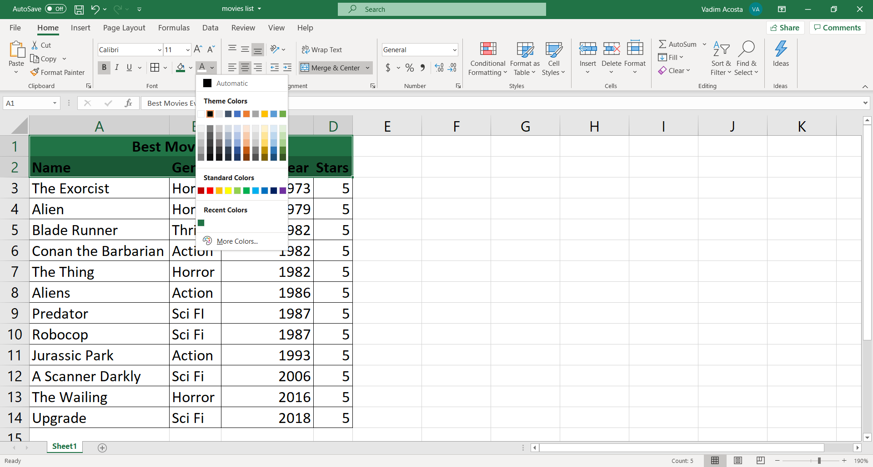
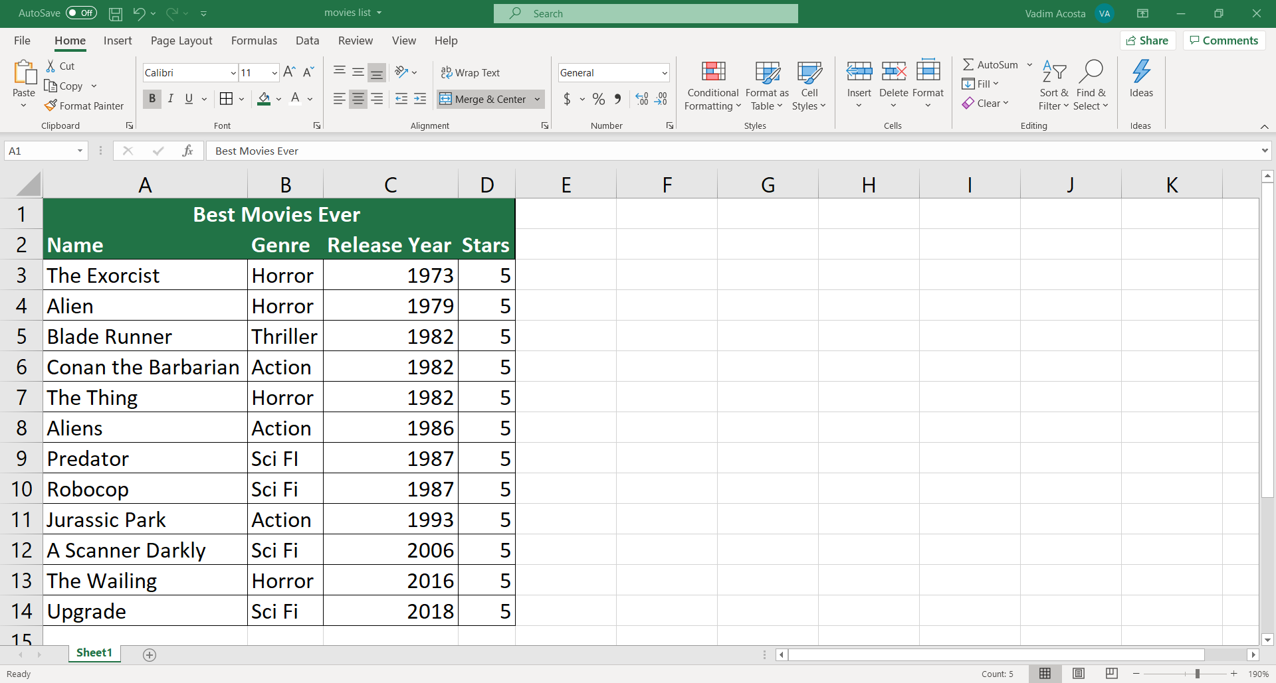
font color
Highlight the cells you want to color click on the downward arrow next to the “A” in the Fonts group
Pick your favorite font color
Voila! A good looking and functional spreadsheet!

Slide 28

Congratulations, you’re now a beginner!

